Slide 1
LOGIC DESIGN OF COMBINATIONAL CIRCUITS
Combinational Logical Function Defined
by Truth Table
Algebraic Method of Representation
Graphical Method of Representation
Implementation of Logical Function
Dynamic Test of Logical Function
Combinational MSI Modules

Slide 2









Combinational Logicl Function
Defined by Truth Table
Logic variables, independent and dependent,
of logic functions are BINARY.
n indep. variables 2^{n} discrete combinations
2^{n} input combinations 2^{n} values on output
2^{n} values on output (2)^{2n} distinct functions
There exist (2)²²=16 distinct 2-var. functions.
Most useful 2-variable logic operations:
A B
0 0
0 1
1 0
1 1
False
0
0
0
0
AND
0
0
0
1
XOR
0
1
1
0
OR
0
1
1
1
NOR
1
0
0
0
XNOR
1
0
0
1
NOT
0 1
0 1
0 0
1 0
NAND
1
1
1
0
True
1
1
1
1

Slide 3

























Algebraic Method of
Representation
Useful Identities of Boolean Algebra (exp.3.1)
Two columns are dual identities w.r.t. each other, i.e., one column can be derived from the other by changing 1 to 0, 0 to 1, AND to OR, and OR to AND.

Slide 4
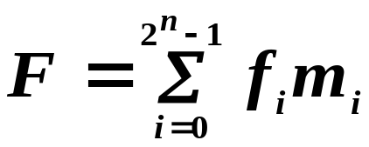




Algebraic Method of
Representation (continued)
From Truth Table to SOP Logical Expression
Sum of minterms Canonical SOP exp.
(exp.3.14)
m_{i} — minterm corresponding to input combination i.
f_{i} = 1 if F=1 for input combination i, otherwise f_{i}=0. f
Example 3.1: Exclusive-OR function
A B
0 0
0 1
1 0
1 1
Minterm
Value of F
0
1
1
0
Canonical SOP exp.
+

Slide 5
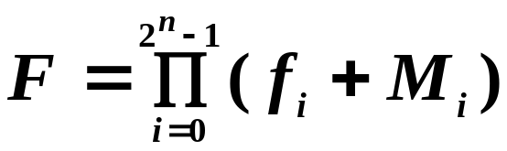




Algebraic Method of
Representation(continued)
From Truth Table to POS Logical Expression
Product of maxterms Canonical POS exp.
(exp.3.15)
M_{i} — maxterm corresponding to input combination i.
f_{i} = 1 if F=1 for input combination i, otherwise f_{i}=0. f
Example of 3.2: Exclusive-OR function
A B
0 0
0 1
1 0
1 1
Maxterm
Value of F
0
1
1
0
Canonical POS exp.
( )( )

Slide 6
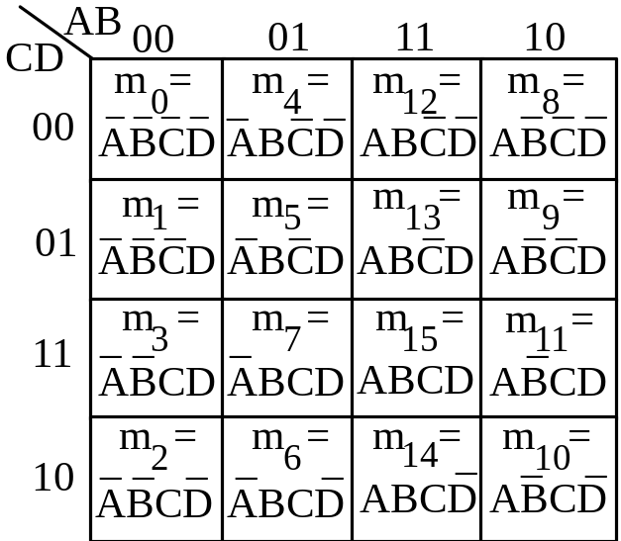
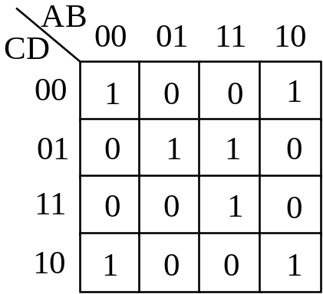
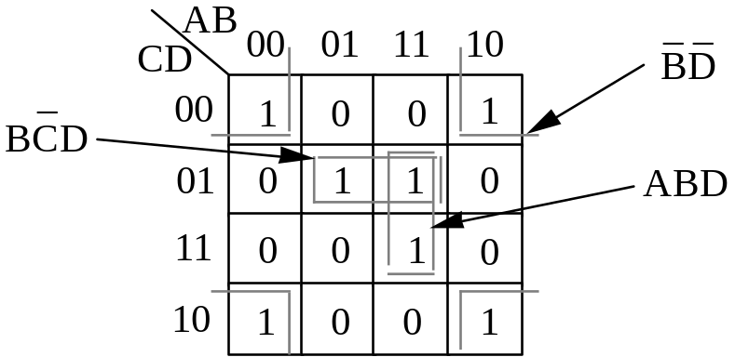
Graphical Method of
Representation
From Karnaugh Map to Logical Expression
Truth table Karnaugh Map
Example 3.3:
A B C D F
0 0 0 0 1
0 0 0 1 0
0 0 1 0 1
0 0 1 1 0
0 1 0 0 0
0 1 0 1 1
0 1 1 0 0
0 1 1 1 0
1 0 0 0 1
1 0 0 1 0
1 0 1 0 1
1 0 1 1 0
1 1 0 0 0
1 1 0 1 1
1 1 1 0 0
1 1 1 1 1
Simplification

Slide 7
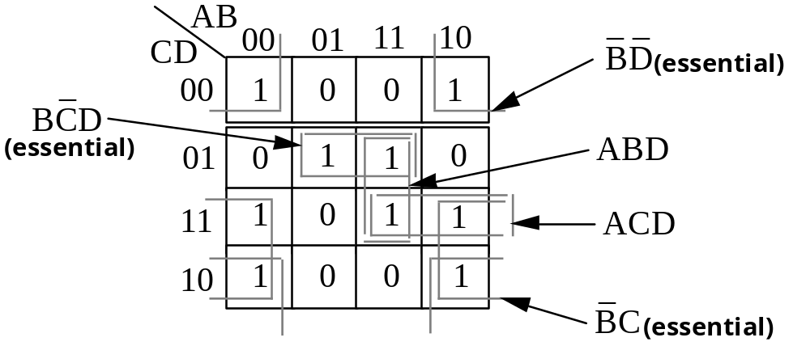


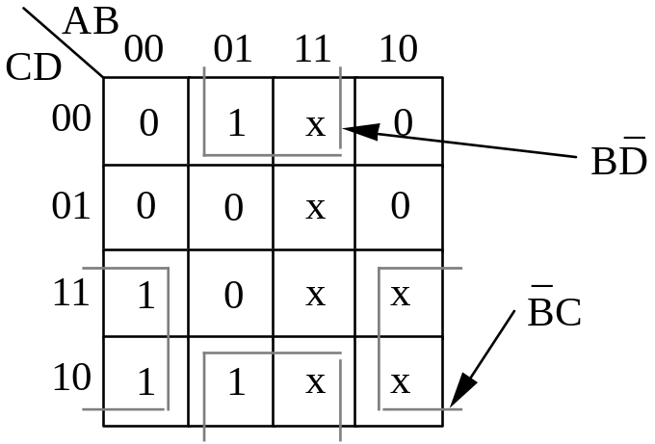

Graphical Method of
Representation(continued)
More on Karnaugh Map Simplification
Simplest solution may not be unique, e.g.,Example3.4
Karnaugh map with don’t care conditions(Example 3.5)

Slide 8
Implementation of Logic Function
Gates Implement Logic Relations
AND is true iff all its inputs are true.
OR is true iff any non-zero number of inputs are true.
NOT is true iff its single input is false.
NAND is false iff all its inputs are true.
NOR is false iff any non-zero no. of inputs are true.
XOR is true iff its two inputs are different.
XNOR is true iff its two inputs are identical.
Multistage XOR has output = true iff any odd no. of
inputs are true, so it implements all odd functions.
Multistage XNOR has output = true iff any even no.
of inputs are true, so it implements all even functions.
AND with some inverted inputs implements a logic of
“inhibit gate”. It is true only if all inhibit inputs are false.

Slide 9
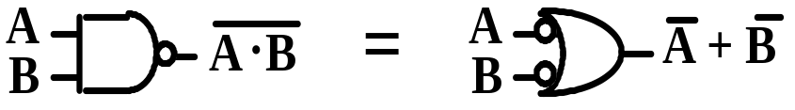
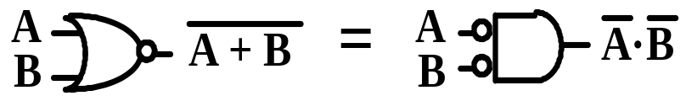
Implementation of Logic Function
(continued)
Properties of NAND and NOR Gates
NAND in positive logic becomes NOR in negative
logic as implemented by the same gate.
Example 3.6
Positive logic
Negative logic
A B F
L L H
L H H
H L H
H H L
A B F
0 0 1
0 1 1
1 0 1
1 1 0
A B F
1 1 0
1 0 0
0 1 0
0 0 1
Concept of Equivalent Gates. Figure 3.5

Slide 10
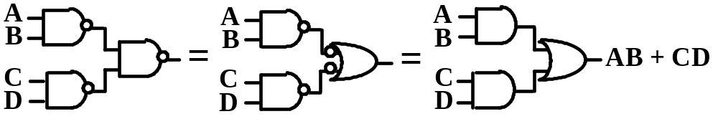
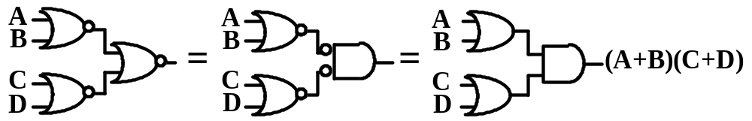
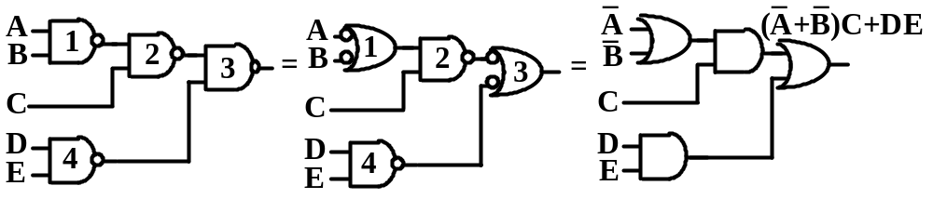
Implementation of Logic Function
(continued)
All-NAND and All-NOR Circuits
2-stage NAND = AND-OR (Example 3.7)
2-stage NOR = OR-AND (Example 3.7)
An example of circuit transformation (Example 3.8)

Slide 11
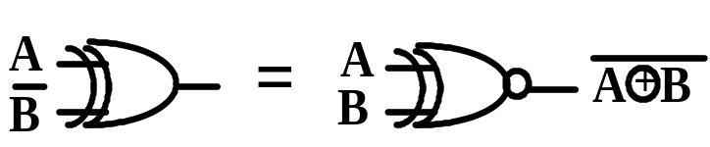
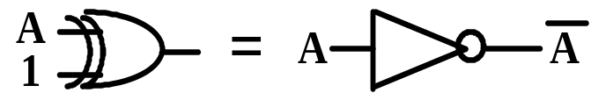
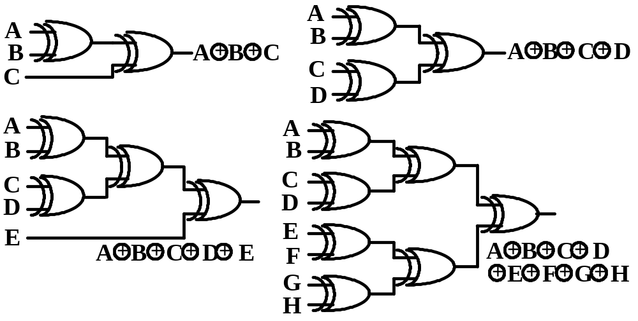
Implementation of Logic Function
(continued)
Properties of XOR and XNOR gates
XOR with one input inverted = XNOR
XOR with one input equal to 1 = NOT
n-input Odd circuits for n = 3,4,5, and 8 (Figure 3.8)

Slide 12
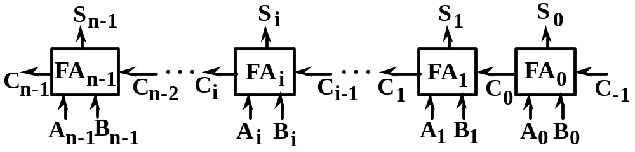
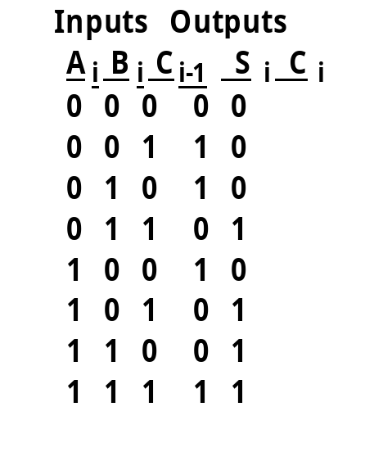
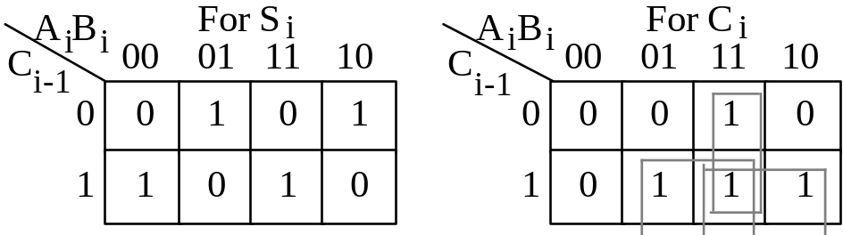
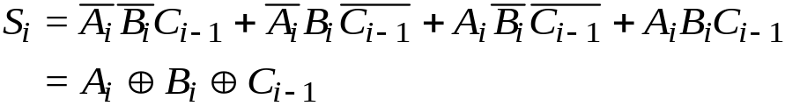
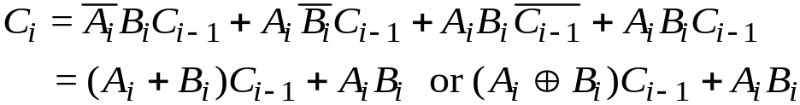
Implementation of Logic Function
(continued)
Example of Designing a Full Adder
Block diagram of n-bit ripple-carry adder (Figure 3.9)
Truth table K-Map Logical expressions (Fig.3.10)

Slide 13
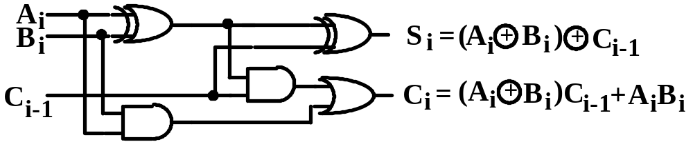
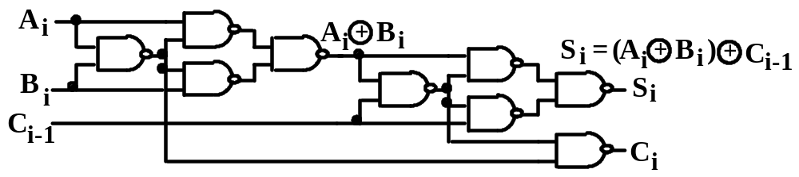
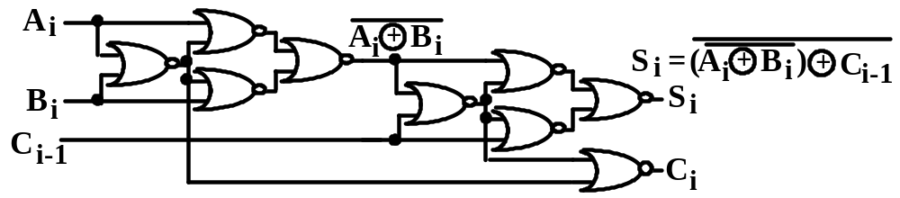
Implementation of Logic Function
(continued)
Various Circuits of Full Adder
XOR-based Circuit of Full Adder (Fig.3.11)
All-NAND Circuit of Full Adder (Fig.3.11)
All-NOR Circuit of Full Adder (Fig.3.11)

Slide 14
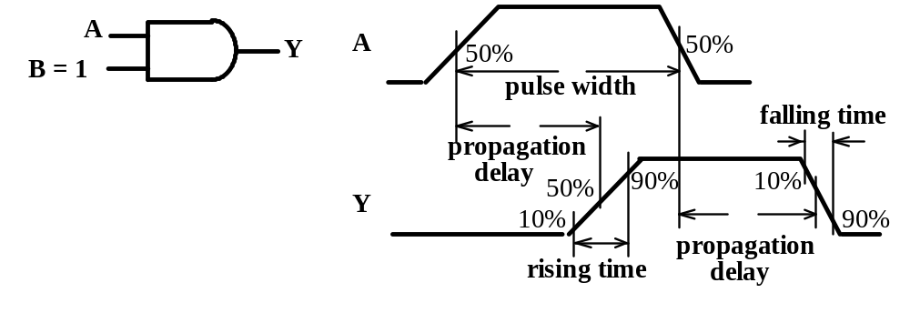
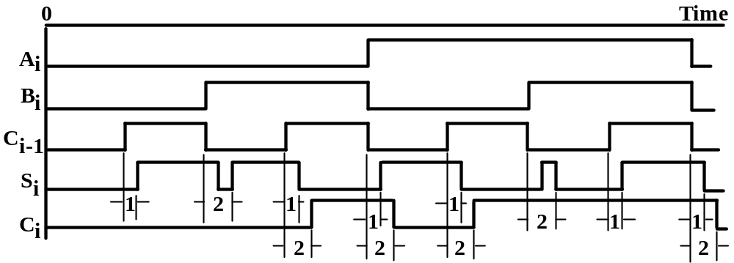
Dynamic Test of Logic Function
Waveform Diagram
Measuring on a real waveform diagram
Measuring on a simulated waveform for
the XOR-based circuit of full adder (Fig.3.16)

Slide 15
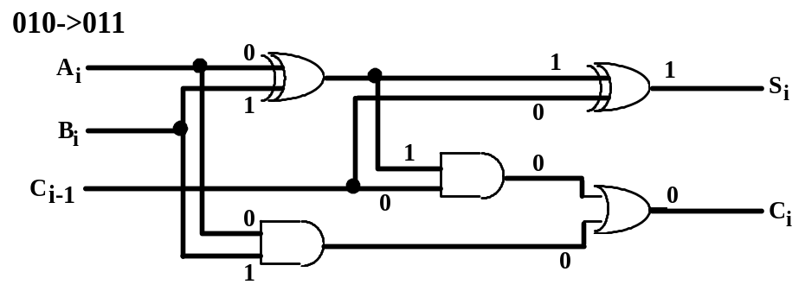
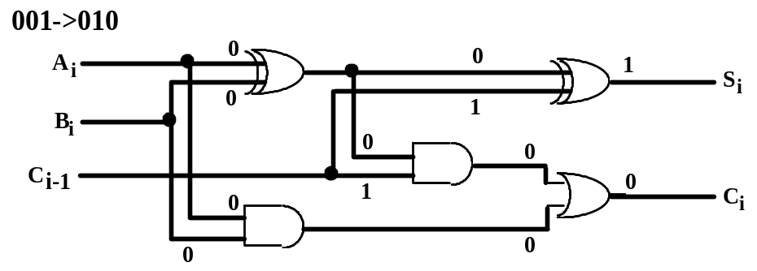
Dynamic Test of Logic Function
(continued)
Analysis of circuit for propagation delay
In XOR-based circuit of full adder for
A_{i}B_{i}C_{i-1} = 010->011 and 001->010.
->0
delay=1
->1
->1
->1
->1
delay=2
->0->1
->0->1
delay=2 with hazard
->1
->0->1
->0->0
->0->0
delay=0
->1
Propagation delay is determined by the critical
(longest) path from a changing input to the
changing output.

Slide 16
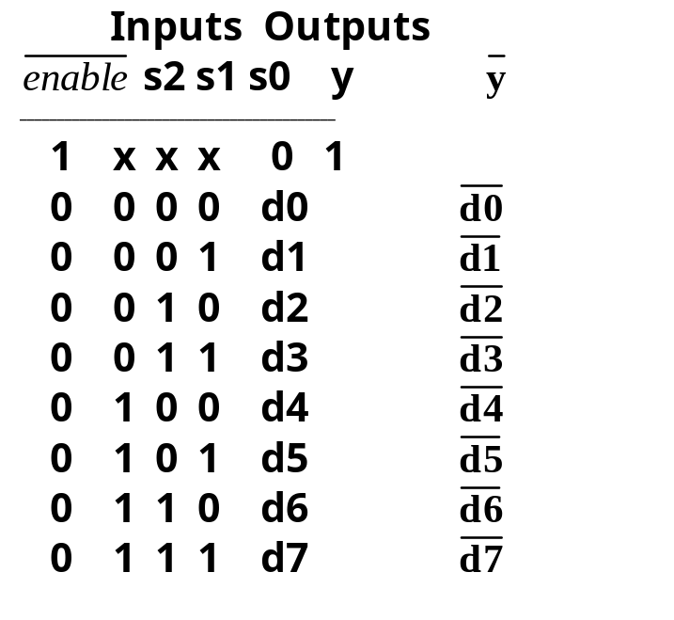
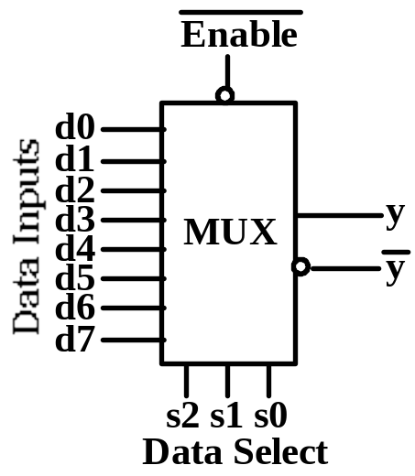
Combinational MSI Modules
Multiplexer
2^{n}x1 multiplexer (n=3) with 2^{n} binary encoded data
inputs selected by n control inputs, 1-2 enable
inputs, and 1-2 (possibly complemented) output.
Symbol and Truth table: (Fig. 3.20, Table 3.12)
works like a single-pole multiple-throw switch.

Slide 17
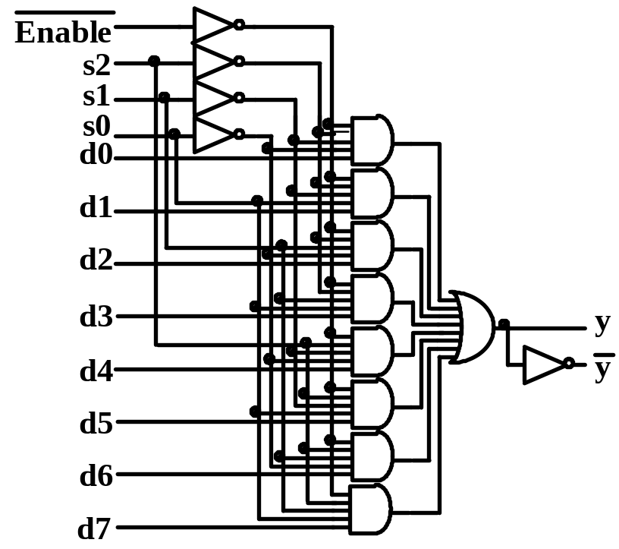
Combinational MSI Modules
(continued)
Implementation of Multiplexer
Truth table Expression and Circuit diagram
(Figure 3.20)

Slide 18
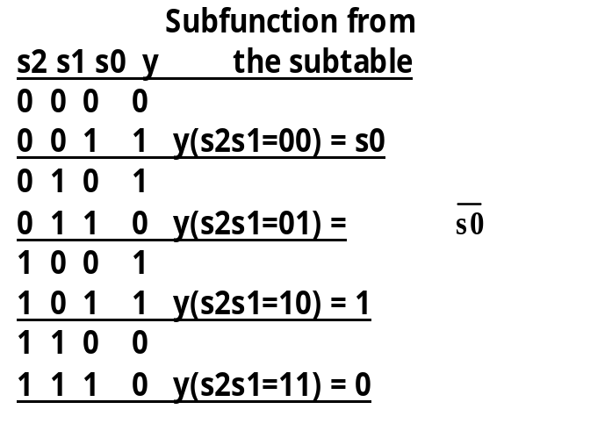
Combinational MSI Modules
(continued)
Use of Multiplexer
Connect multiple sources to a single destination.
Parallel-serial conversion.
Combinational shifter.
General-purpose combinational function generator.
Example 3.13: Implement y(s2,s1,s0)= m1+m2+m4+m5
Solution 1: Use 8x1 MUX with ‘1’ to d1,d2,d4,d5, & ‘0’ to others.
Solution 2: Use only one 4x1 MUX with s0,s0,1,0 to d1-d3 resp.
Solution 1
Solution 2
1
1
d0
d1
d2
d3
d4
d5
d6
d7
s0
d0
d1
d2
d3
y
MUX
y
MUX
s2 s1
s2 s1 s0

Slide 19
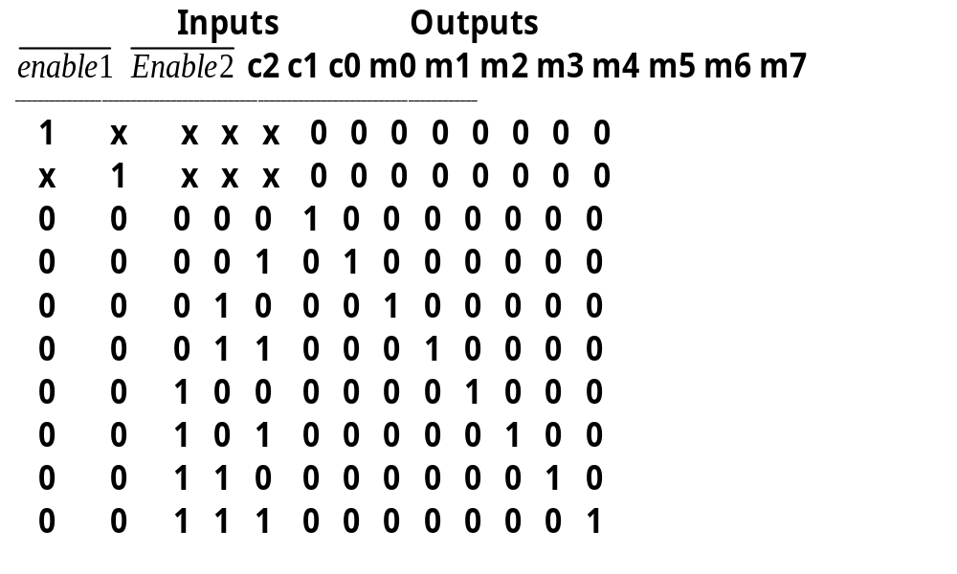
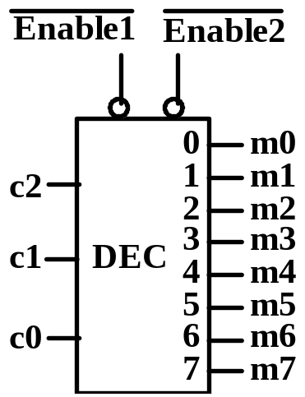
Combinational MSI Modules
(continued)
Decoder/Demultiplexer
nx2^{n} decoder (n=3) with n binary coded inputs, 1-2
enable inputs, and 2^{n} mutually exclusive outputs
(minterms) corresponding to the input code.
Symbol and Truth table: (Fig.3.24, Table 3.14)

Slide 20
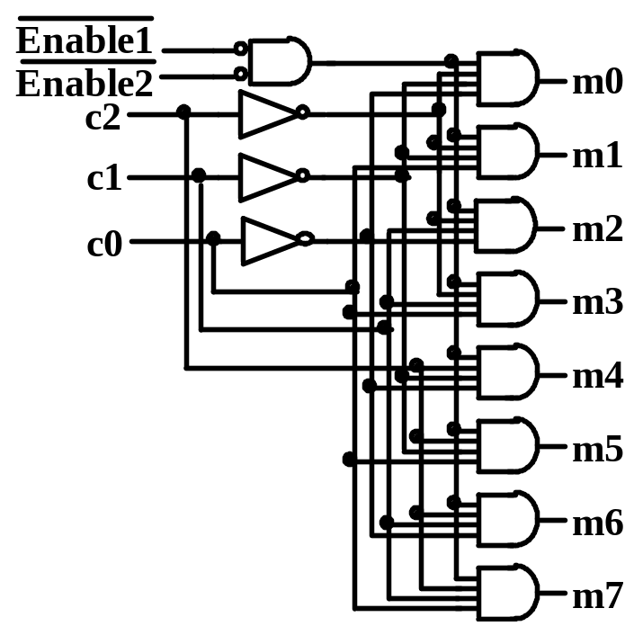
Combinational MSI Modules
(continued)
Implementation of Decoder/Demultiplexer
Truth table Expression and circuit diagram (Fig.3.24)
mi = Enable1 Enable2 (input code = i) for i=0 to n-1

Slide 21
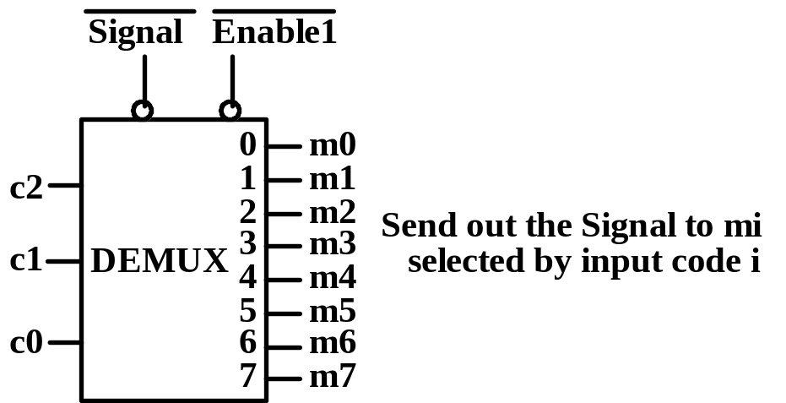
Combinational MSI Modules
(continued)
Use of Decoder/Demultiplexer
Address decoder — select a memory
address or a register number.
Operational decoder — decode instruction
Opcode or microinstruction fields.
Demultiplexer — dispatch a single-source
to one of multiple destinations

Slide 22


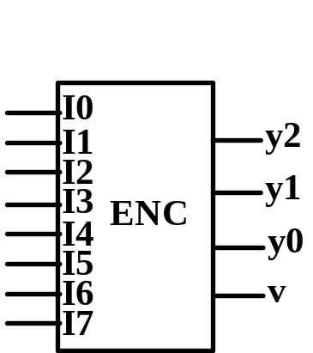
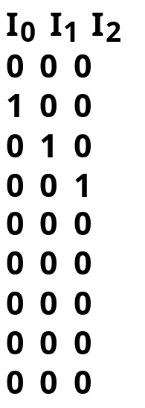
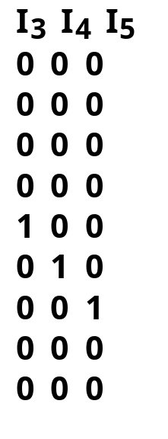
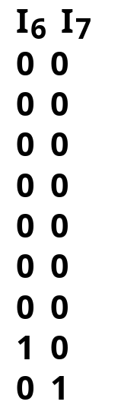
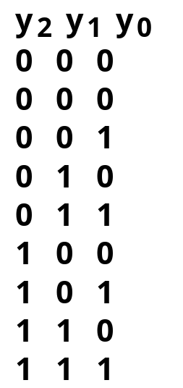

Combinational MSI Modules
(continued)
Encoder
2^{n}xn encoder (n=3) with 2^{n} inputs and n
binary coded outputs plus a presence bit.
“translate” an active I_{i} input into its corres- ponding binary code i for i = 0,1,…,n-1.
v=1 validates the output for any input I_{i} =1.
(Fig.3.26, Table 3.15)

Slide 23
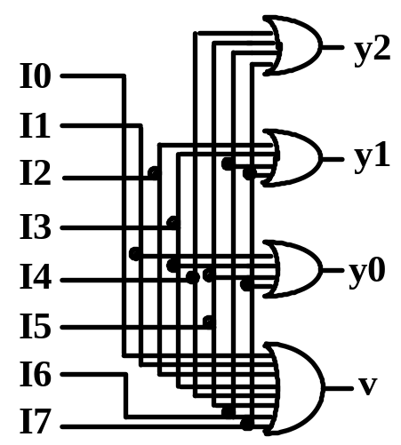
Combinational MSI Modules
(continued)
Implementation of Encoder
Truth table Expression and Circuit diagram
(Fig.3.26. exp.3.39)
y2=I4+I5+I6+I7
y1=I2+I3+I6+I7
y0=I1+I3+I5+I7
v=I0+I1+I2+I3+I4+I5+I6+I7
Use of Encoder:
◊ Encode the exception request signals.
◊ However interrupt requests may not be
mutually exclusive, so priority encoder.

Slide 24
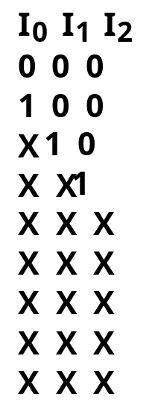
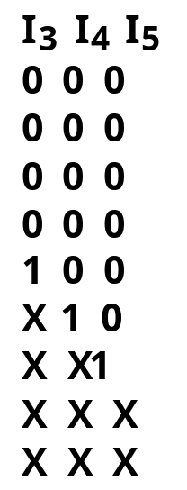
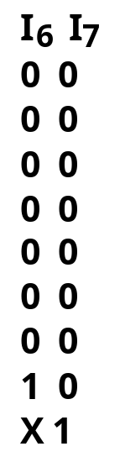
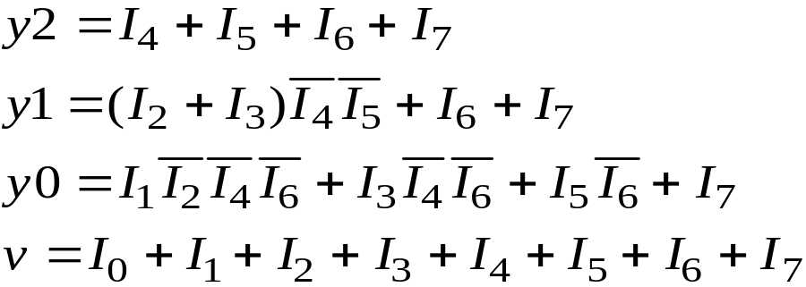
Combinational MSI Modules
(continued)
Priority Encoder
I_{i} has a higher priority than i_{j} if i>j.
(Table 3.16)
(exp.3.40)

